Slide 1
Gosu for Integration
October 15, 2013
Notes:
Guidewire training materials contain Guidewire proprietary information that is subject to confidentiality and non-disclosure agreements. You agree to use the information in this manual solely for the purpose of training to implement Guidewire software solutions. You also agree not to disclose the information in this manual to third parties or copy this manual without prior written consent from Guidewire. Guidewire training may be given only by Guidewire employees or certified Guidewire partners under the appropriate agreement with Guidewire.

Slide 2
Describe the places where an integration developer uses Gosu
Create Gosu classes
Use blocks as input parameters
Generate unique, sequential numbers

Slide 3
Overview of Gosu for integration
Gosu classes
Blocks
Sequential numbers

Slide 4
Review: Guidewire Gosu
Gosu is Guidewire’s open-source, publicly available programming language
Has elements of both procedural and object-oriented programming languages
Similar to JavaScript and Java
Gosu specifies runtime business logic that:
Executes fundamental application behavior
Manages complex business processes
Specifies dynamic client-side behavior
Notes:
Guidewire developed Gosu for several reasons.
First, there was a desire to have a single syntax that could be used to work with all of the elements relevant to Guidewire products (such as entities, display keys, classes, class enhancements, Java classes, permissions, and script parameters) even though these items have fundamentally distinct internal implementations. There was no existing language that provided this ability.
Second, there was a desire to have code auto-complete features in Studio. This is possible only with a statically typed language. Most scripting languages, such as JavaScript, Perl, Python, and Ruby, are dynamically typed.
Prior to ClaimCenter 6.0, PolicyCenter 4.0, and BillingCenter 3.0, Gosu was known as GScript.

Slide 5
Where is Gosu used for integration? (1)
Predefined plugins
Executes fundamental application behavior, such as authentication
Startable plugins
Specifies how to listen for incoming messages initiated by external systems and how to reply to them
Messaging plugins
Asynchronously sends messages and processes acknowledgements
Messaging
Event Fired rules
Creates messages and generates payloads

Slide 6
Where is Gosu used for integration? (2)
Batch processes
Specifies logic to run on a periodic basis
Web services
Specifies methods made available to external applications for synchronous web service calls
Integration logic triggers include:
Non-messaging business rules
PCF actions (such as button clicks)
Workflows
WS-I
Notes:
Workflows execute processes whose execution is time based and/or triggered by events in external applications. Workflows are available in all three primary Guidewire applications. They are used extensively in PolicyCenter to manage policy transactions (such as renewals), and in BillingCenter to manage account delinquency and agency bill cycles. The feature is available in ClaimCenter, and the base application provides one workflow for metropolitan report integration. This workflow is not enabled in the base application, but it can be enabled via config.xml.

Slide 7
Gosu features and benefits
Code is more compact
Direct access to Guidewire data model
Development time is shorter
Reload Classes or Make Project
Guidewire Studio supports Gosu coding
Code completion
Syntax checking
Navigable links
Robust interaction with Java
Easy to learn by Java programmers
Has access to all Java types and can reference Java classes
Notes:
Gosu is based on the ECMAScript language standard. Gosu provides a unified type model that lets types from extremely different sources such as database entities, Java types, and user interface elements interact together seamlessly. Gosu has a rich object-oriented programming feature set that includes classes, interfaces, and polymorphism.

Slide 8
Gosu skills fundamental for integration
Integration points involve these skills:
Creating and modifying classes, including:
Declaring and referencing properties and methods
Extending classes
Creating and implementing interfaces
Using blocks as input parameters
Generating unique or sequential numbers
Writing queries to retrieve data from the Guidewire database
Manually committing data to the database
Using existing Java types and classes
Notes:
This lesson discusses Gosu classes, blocks, and unique, sequential numbers.
The remaining features (queries, committing data, Gosu/Java interoperability) are covered in the next three lessons.

Slide 9
Additional Gosu features
Advanced object-oriented design
Enums
Generics
Custom annotations
Numeric literals
Intervals
Null-safe operators
Data transformation
The XmlElement class (to import, modify, and/or export XML)
The typecode mapper (to map Guidewire typecodes to external system typecodes and vice versa)
Testing
Entity builders
GUnit tests

Slide 10
Overview of Gosu for integration
Gosu classes
Blocks
Sequential numbers

Slide 11
Gosu class features
Gosu classes are similar to classes in other object-oriented language, such as Java
Classes are organized in packages
Classes can define:
Constructors
Properties (with private and public access)
Methods (with private and public access)
Classes can:
Extend other classes
Implement interfaces
Override methods
Notes:
There are some minor variations between the terminology used for Gosu classes and Java classes.
Java term Gosu term
Method Method (declared using the key word "function", so there are times they are also referred to as functions)
Field Variable
Property No direct equivalent, though manipulation of the variable's values may be done through get() and set() methods
Constructor Constructor (declared using the key word "construct", so there are time this is also referenced as a construct() method)

Slide 12
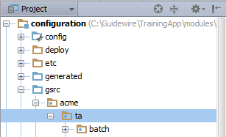
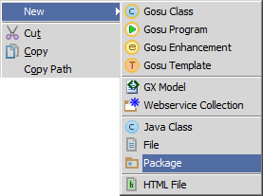
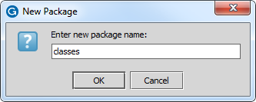
Creating Gosu packages
/configuration/gsrc/
Create package
New → Package
Guidewire naming convention recommendation
<company>.<app_code>.mechanism.<functional_area>
mechanism is typically batch, messaging, plugin, startable, webservice, and of none of the others apply, then use class
Notes:
A package is a collection of classes grouped together because:
They perform related logic, and/or
They should have access to each other while classes outside the package should not (though this usage of packages is less common).
Packages are always arranged in a hierarchy.
To create a package:
Right-click package that is to be parent of new package.
Name the package. The name must be unique for the given parent.
The package roots "com.guidewire" and "gw" are reserved. You should not create any child packages in either of these packages.
(continued)

Slide 13
Notes:
Recommended naming convention for packages. Package named should be entirely lower case.
Gosu: <company>.<app-abbrv>.<mechanism>.<functional_area>
Java: com.<company>.<app-abbrv>.<mechanism>.<functional_area>
where...
<company> is the company's name or a suitable abbreviation.
<app-abbrv> is the Guidewire application's two-letter abbreviation:
PolicyCenter: pc
BillingCenter: bc
ClaimCenter: cc
ContactManager: cm
TrainingApp: ta
<mechanism> is one of:
batch
messaging
plugin (for predefined (non-messaging, non-startable) plugins)
startable
webservice
class (for any package that isn't covered by one of the above mechanisms)
<functional_area> is the functional area of the application.

Slide 14
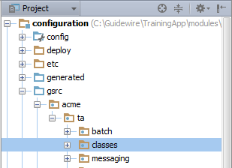
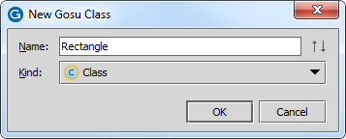
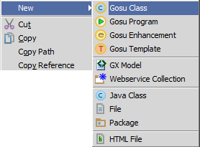
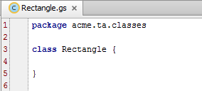
Creating Gosu classes
Naming convention for a class:
<meaningfulName>API
New class file has empty constructor
Notes:
Object-oriented programming is a programming approach in which developers:
Create classes, which are instructions for how to build a set of objects and the properties and behaviors those objects will have
Create and manipulate individual objects, known as instances
Every class is created by a class definition, which specifies (among other things):
The name of class
Properties that every instance of the class has (The Rectangle shown above does not yet have any properties.)
Methods that every instance of the class has (The Rectangle shown above does not yet have any methods, except the standard construct() method.)
The recommended capitalization convention for classes is to use camelcase (such as RoundedRectangle).
Just like Java, access to Gosu classes, variables, properties, and methods can be controlled using access keywords (public, protected, internal, private). However, the defaults for Java and Gosu are not the same. In Gosu:
The default access for a class is public.
The default access for a variable is private.
The default access for a property is public.
The default access for a method is public.
Java's "default" access level is known in Gosu as "internal".
(continued)

Slide 15
Notes:
To create a class:
Right-click the package which is to contain the new class.
Name the class. The name must be unique for the given package.
A constructor is a special method that is executed whenever an instance of that class is created. This method can be used to initialize objects or run any other logic appropriate to the creation of a new instance. In Gosu, the constructor is named construct(). Many classes doesn't required a constructor. For these classes, it can be omitted.

Slide 16
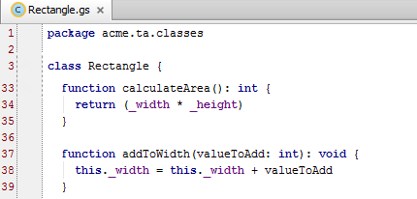
Methods
Methods are declared using the keyword function
Methods can be private or public
Like Java, methods can refer to the instance from which the method is called using the key word this
Notes:
A method is a set of one or more lines of code that can be executed from instances of a class. Similar to properties, methods can also be private (available only to other methods in the defining class) or public (available to any method in any class). The recommended capitalization convention for methods is to use camelcase with an initial lower-case letter (such as assignToNextAvailableUser). Just like Java, access to Gosu methods can be controlled using access keywords (public, protected, internal, private). However, the defaults for Java and Gosu are not the same. In Gosu, the default access for a method is public.
The "this" keyword refers to the instance of the class from which the method is called. For example, if you had an instance of Rectangle named rectangle17 and you executed rectangle17.addToWidth(3), then the code as shown above on line 38 would logically be equivalent to "rectangle17._width = rectangle17._width + 3".
A method that has input parameters is typically a method that has been abstracted to work in a variety of situations. It is not unusual to see strings, numerics, booleans, and objects as input parameters.
In some situations, a method can be abstracted to work in a variety of situations. But the "value" that varies from each situation is an algorithm or a set of logic. For example, the where() method on an array returns all items in the array that match a given criteria. In this case, it is the criteria that needs to be supplied to the method. Later in this lesson you will see an example using blocks.

Slide 17
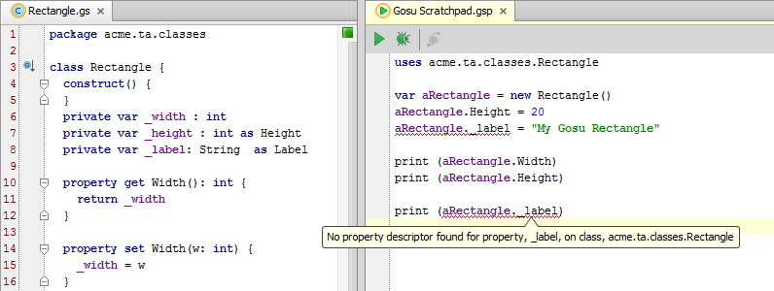
Properties
In Gosu, a property is a private variable whose value is manipulated publicly through getters and setters
Shorthand is to declare the property with the as keyword
private var _label: String as Label
Notes:
A property can be thought of as a value associated with an object. A property has a type and its value can be retrieved or set. There are two approaches to having instance-specific values that can be manipulated:
You can create a field and explicitly set its access to public. This lets any method in any other class access and modify the value. However, this violates the idea of encapsulation and is not recommended.
You can create a private variable that methods of the class can access, but methods of other classes cannot access. Setting the variable to private ensures that only the class's methods are allowed to directly modify the variable's value.
In Gosu, the recommended naming convention is to:
Name private variables with an initial underscore followed by a lower case letter and otherwise using camelcase, such as "_aPrivateVariable".
Name a non-public property with an initial capital letter, such as "APublicVariable". (This is unlike Java naming conventions, where properties are "implied" from the get and set methods, and considered to have lowercase names, such as aPublicProperty.)
Just like Java, access to Gosu variables and properties can be controlled using access keywords (public, protected, internal, private). However, the defaults for Java and Gosu are not the same. In Gosu:
The default access for a variable is private.
The default access for a property is public.
Properties can be declared as static. This creates a "class-level" property that is accessible from the class itself. (You can access a static property even when you do not have any instance of the class.)

Slide 18
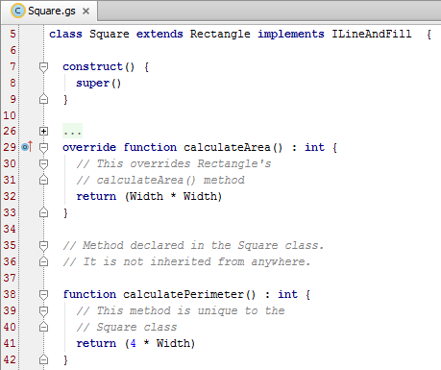
Extending a class
To extend a class
add extends superClass to the class declaration
Super keyword gives you access to aspects of the superclass
Override keyword lets you override methods declared in the super class
Access to inherited properties
As declared in the superclass, the class can access non-private properties and methods
Notes:
When one class extends another, the extending class (Square in the example above) is said to be a subclass of the extended class (Rectangle in the example above). The subclass automatically has access to all non-private properties and methods in the superclass.
The super() method references the method declaration of the parent class. For example, line 6 in the code above identifies that the constructor for Square should use the constructor declared for Rectangle.
The override keyword lets you create an alternate declaration for a method declared in the superclass. For example, lines 9 through 13 in the example above override the Rectangle class's calculateArea() method, which returns "(Height * Width)", with an alternate method: "(Width * Width)".
Subclasses may override individual property accessors (the get() and set() methods used to set property values).
As in Java, Gosu supports the keywords "abstract" (which means you cannot create an instance of the given class and can only create instances of its subclasses) and "final" (which means you cannot further subclass the given class).

Slide 19
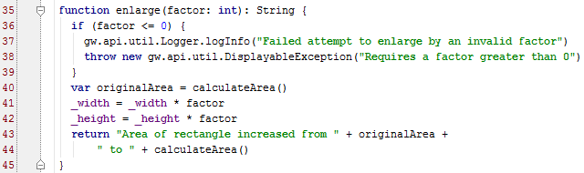
Logging
Write to the log using the logger class
gw.api.util.Logger.logTypeXX("logString")
TypeXXX is for
Trace, Debug, Info, Warn,
Error
Notes:
For any enterprise software application, logging is a vital component for recording information about system behavior that is required for diagnostics, trouble-shooting, and failure recovery. Log messages are organized sets of information saved in a separate file that can be reviewed at any point after they have been written to the log.
Guidewire logging makes use of the Log4j levels of severity: Trace, Debug, Info, Warn, Error.
Each level is considered more severe than the previous.
Logging is controlled from the logging.properties file in the config/logging directory. The file specifies different categories of logging and the logging level for each category. When a logging statement is encountered that is at or above the specified level, the log message is written to the file. The properties file lets an administrator control the depth of logging without having to change any application code.
You can check for the level of logging using the isXXXEnabled() methods on a Logger instance. For example, if there is some overhead associated to the creation of a debug statement's string, you could check to see whether the logging level is at debugging and avoid the construction of the string if this isn't the case.
if ( logger.isDebugEnabled() ) { //avoid creating unused strings
logger.debug("Logging at debug level using object1 " + obj1 + " and object2 " + obj2 + ".")
}
(continued)

Slide 20
Notes:
In a production system, logging statements should always be used instead of print() statements. This is one best practice that TrainingApp does not follow, but it deviates from the best practice strictly for educational purposes. (In the classroom environment, the student is constantly interacting with the system, and therefore checking the console is usually faster than looking in a log file. In a production environment, the administrator is rarely at the console when an important event occurs. Finding the output of a print statement after an error occurred can be time-consuming and, in some cases, impossible.)

Slide 21
Exception handling
Gosu can make use of try...catch...finally blocks
Gosu code can throw Gosu and Java exceptions
Notes:
The try...catch...finally blocks provides a way to handle some or all of the possible errors that may occur in a given block of code during runtime. If errors occur that the code does not handle, Gosu simply provides its normal error message, as if there were no error handling.
The try block contains code where an error can occur, while the catch block contains the code to handle any error that does occur. If an error occurs in the try block, Gosu passes program control to the catch block for processing. The initial value of the error-identifier is the value of the error that occurred in the try block.
If an error is thrown from Java code, the value is the exception or error that was thrown. Otherwise, the value is an exception thrown elsewhere in Gosu code.
If no error occurs, Gosu does not execute the catch block. If the error cannot be handled in the catch block associated with the try block where the error occurred, use the throw statement. The throw statement throws the exception (again) to a higher-level error handler.
After all statements in the try block have been executed and any error handling has occurred in the catch block, the finally block is unconditionally executed.
Gosu executes the code inside the finally block, even if a return statement occurs inside the try or catch blocks, or if an error is thrown from a catch block. Thus, Gosu guarantees that the finally block executes.

Slide 22
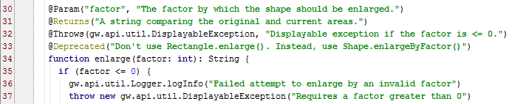
Gosu classes support annotations
An annotation is an expression starting with an "@" that provides metadata about a Gosu element
Gosu provides four annotations for general class and method documentation (as shown above)
Notes:
Annotations are a simple syntax to add metadata to a Gosu class, constructor, method, or property. You can add completely custom annotations, and this information can be read at run time. When you use an annotation, use the "at" sign (@), followed by the annotation name, immediately before declarations of what they annotate. In most cases, the annotation name is followed by an argument list within parentheses. There are four annotations that document basic element behavior:
@Param - Documents a parameter. Must be followed by two arguments: (1) The name of the parameter, (2) The documentation in Javadoc format for the method’s parameter. (Used for methods only. It can be used multiple times, typically once for each parameter)
@Returns - Documents the return value of a method. Must be followed by one argument: (1) Documentation in Javadoc format for the method’s return value. (Used for methods only, and only once per method.)
@Throws - Documents an exception that the method can throw. Must be followed by two arguments: (1) An exception type. (2) A description in Javadoc format of the circumstances when it would throw that exception, and how to interpret that exception. (Used for methods only. It can be used multiple times, typically once for each exception thrown)
@Deprecated - Specifies not to use a class, method, constructor, or property. Must be followed by one argument: (1) A warning string to display if this deprecated class, method, or constructor is used. (It can be used for any element, but only once for each element.)
There are additional annotations exclusive to web services. Annotations on supertypes are inherited by all subtypes. They are directly available via IType reflection on the subtype.
Customers can also create custom annotations. Refer to documentation about how to create your own custom annotations.

Slide 23
Overview of Gosu for integration
Gosu classes
Blocks
Sequential numbers

Slide 24
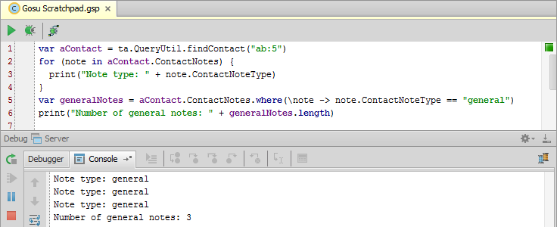
Blocks
A block is an unnamed method that is typically created as an input parameter for another method
For example, an array's where() method takes a block that specifies a certain criteria and returns the elements in the array that match that criteria
Notes:
A block is a method that is not declared using a formal key word (such as "function"), has no name, and is typically never referenced beyond the one time it is created. Blocks contain algorithms or sets of logic, and therefore are ideal for methods that must vary based on a set of statements.
Blocks are sometimes referred to as anonymous functions or lambda (λ) expressions.
Like named functions, blocks can:
Take arguments
Use return
Reference variables from enclosing scopes
Be generic
Unlike named functions, blocks can:
Be an expression
Be passed as an argument to another function for invocation

Slide 25
Block syntax
Syntax: (\argument(s) -> logicToExecute)
var generalNotes = aContact.ContactNotes.where(\note -> note.ContactNoteType == "general")
In most cases, the object is iterable
"note" is a placeholder name for elements from the array
The where method returns all members of the array where the block's Boolean condition is true
Notes:
Type inference makes types in the arguments list optional in some cases. For example, the where() method expects the object to be of type ContactNotes[].
The return type is also inferred from the block body’s expression or return statement. It is never explicitly typed.
References to variables from outer scopes are an important feature:
The block sees the value of a referenced variable as of when the block is invoked, not when defined.
Variables referenced from a block do not go out of scope before the block executes. They are snapshots of the most recent values.
The primary use case for blocks are with methods that require blocks as input parameters. However, you can also use blocks whenever an unnamed function is an appropriate approach to a coding problem.

Slide 26
Overview of Gosu for integration
Gosu classes
Blocks
Sequential numbers

Slide 27
The sequence utility
The sequence utility is a Guidewire class that is used to generate unique, sequential numbers
Useful for business cases requiring numbers that are sequential or unique
The Guidewire database stores sequence information
For each sequence, it maintains a record of the last number provided
The next() method is used to request numbers
The database provides the next number in the given sequence

Slide 28
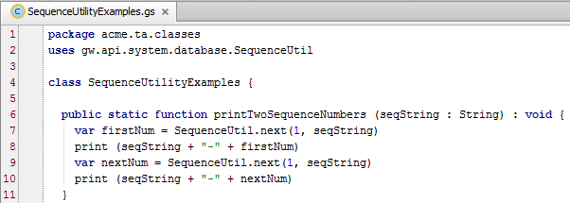
Using the sequence utility
Syntax: gw.api.system.database. SequenceUtil.next(minVal, seqKey)
Notes:
The SequenceUtilityExamples class shown above can be found in TrainingApp in both the trainingapp.demo.gosu and the acme.ta.classes packages.
Syntax notes:
seqKey is the Sequence key. It is a string of up to 26 characters that uniquely identifies the sequence.minVal is the minimum value, of type Long, for the sequence. It specifies the value to use if this is the first request for a number in the specified sequence. On all requests beyond the first one, this value is ignored.The return value is the next number in the sequence and is of datatype long.
When a sequence is started, it will issue the provided minValue as its first value. After that, the returned value is simply the most recently returned value plus one. The next() function is designed to be consistent across different database products.
(continued)

Slide 29
Notes:
On and before the Bedrock platform (ClaimCenter 5.0, PolicyCenter 3.0, and BillingCenter 2.x), next() was a non-blocking method. If it failed to get a value after a set number of tries, then it threw an unchecked exception. The number of tries was configurable. As of the Carbon platform (ClaimCenter 6.0, PolicyCenter 4.0, and BillingCenter 3.0), next() is a blocking method. The Carbon implementation gets an UPDATE lock on the row. This does cause blocking until the lock is acquired, but it results in much faster performance in a multiuser environment and eliminates the problem of exceptions that could occur in the Bedrock implementation when the specified number of retries was exceeded. Behavior on the Diamond platform (ClaimCenter 7.0, PolicyCenter 7.0, and BillingCenter 7.0) is identical to that of the Carbon platform.
Note that if a request for the next sequence value blocks for a long period, due to waiting for the update lock, there may be an exception thrown from elsewhere, such as from the database Connection object. JDBC connection implementations typically throw an exception if no reply is received through the connection after a certain timeout period. Therefore implementations using the SequenceUtil should be prepared for an exception throw from calls to next(). The next() implementation itself will not directly throw a new exception.
The Java API for plugins exposes a similar sequence utility in guidewire.pl.plugin.util package.
The Java and Gosu APIs for plugins expose an entity called Sequence that represents the sequences in the xx_sequence table.

Slide 30
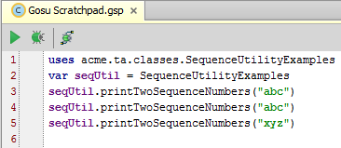
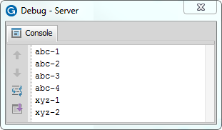
SequenceUtil in action
Gosu Scratchpad
Line 3:
First call "abc"
Line 4:
Second call "abc"
Line 5:
Third call with "xyz"
Call "abc"
Call "abc"
Call "xyz"
Notes:
The screenshots above show a simple example of using SequenceUtil.
The first line of the Gosu Tester code is a call to the printTwoSequenceNumbers() method for a sequence whose key is "abc". In the printTwoSequenceNumbers function, there are two calls to next(). Line 9 is the first call. Because there have been no previous calls for the "abc" sequence, the minimum value of 1 is returned. Line 10 simply prints the sequence key followed by a hyphen and the number returned. On line 11, a second call is made to next(). Because this is not the first call using the "abc" sequence, the minimum value is ignored and the method returns the next number in the sequence. (In this case, it is 2.)
The second line of the Gosu Tester code is a second call to the printTwoSequenceNumbers method for sequence "abc". In the printTwoSequenceNumbers function, lines 9 and 11 call the next() method. Neither of these calls are the first call for sequence "abc", so the next numbers in the sequence (3 and then 4) are returned.
The third line of the Gosu Tester code is a third call to the printTwoSequenceNumbers method. This time, sequence "xyz" is specified. Because this is a new sequence, the first call to next() uses the minimum value of 1, followed by 2.
SequenceUtil reads information from the Guidewire database and writes information to it. Therefore, in order to test SequenceUtil code from Studio:
The application must be running.
Studio must be connected to the application.
If either of these conditions is not true, then calls to SequenceUtil.next() throw a null-pointer exception.

Slide 31
Describe the places where an integration developer uses Gosu
Create Gosu classes
Use blocks as input parameters
Generate unique, sequential numbers

Slide 32
A Gosu class is named Circle. Each instance must have a property for the circle's radius. (This value can be accessed and modified by methods in the Circle class, but not by methods in other classes). How many elements must you create to implement this?
The Circle class extends the Oval class and implements the ICurveLine interface.
Can Circle override methods from Oval?
Can Circle override methods from ICurveLine?
What is the purpose of an annotation?
What types of methods make use of blocks?
(continued)
Notes:
Answers
1. Three. (1) A private variable named _radius. (2) A get() method that retrieves the value of _radius. (3) A set() method that sets the value of _radius.
2.a) Yes.
b) From a keyword standpoint, yes. If Circle implements the ICurveLine interface, then Circle must implement all the methods of the ICurveLine interface using the keyword "override". (However, because ICurveLine is an interface, the Circle class is actually just declaring the implementations of the methods. There are no method implementations in an interface, so there is nothing to "override" from an OOP standpoint.)
3. An annotation provides metadata about the element being annotated.
4. Methods that require logic as input parameters (as opposed to booleans, integers, strings, and/or objects) make use of blocks.

Slide 33
If the only sequence in the database has a key of "abc" and the last number issued for sequence "abc" was 7, what will be the return value of the following:
SequenceUtil.next(1, "abc")
SequenceUtil.next(15, "abc")
SequenceUtil.next(1, "cba")
Notes:
5.a) 8 (The sequence has already issued a number (7), so the minimum number is ignored and the next number in the sequence is returned.)
b) 9 (The sequence has already issued a number (8), so the minimum number is ignored and the next number in the sequence is returned.)
c) 1 (The sequence is not the "abc" sequence. With no numbers having been issued for the sequence, the minimum value of "1" is returned.)

